Slide 1
Comments and suggestions on the draft CERC(DSM First Amendment) Regulations, 2024.

Slide 2
Definition of Contract Price
Amendment
Sub Clause (j) of clause (1) of Regulation 3 of the Principal Regulations shall be substituted as under:
“((j) ‘Contract rate’ means (i) in respect of a WS seller or a MSW Seller or such other entity as applicable, whose tariff is determined or adopted or approved under Section 62 or Section 63 or Section 86(1)(b) of the Act, Rs/kWh tariff as determined or adopted or approved by the Appropriate Commission; or (ii) in respect of a WS seller or a MSW Seller or such other entity as applicable, whose tariff is not determined or adopted or approved under Section 62 or Section 63 or Section 86(1)(b) of the Act, and selling power through power exchange(s), the price as discovered in the Power Exchange for the respective transaction; or (iii) in case of captive consumption of a captive generating plant based on renewable energy sources in respect of a WS seller or a MSW seller or such other entity as applicable, selling power through open access to a third party or, the weighted average ACP of the Integrated-Day Ahead Market segments of all Power Exchanges for the respective time block; in case of captive consumption of a captive generating plant based on renewable energy sources in respect of a WS seller or a MSW seller or such other entity as applicable, selling power through open access to a third party, either of (a) higher of the average REIA price discovered in bids for the month when the renewable energy generating plant for relevant technology (solar, wind, hybrid etc) are partly or fully commissioned or the transfer price agreed between captive parties as mentioned in their transfer pricing agreement or any similar agreement, OR b) average REIA price discovered in bids for each month of relevant technology (solar, wind, hybrid etc) when the renewable energy generating plant is partly or fully commissioned. For both options a) and b) the REIA price for the month when the capacity is fully commissioned shall be the final REIA price throughout the life of the project (iv) in case of multiple contracts or transactions including captive consumption, the weighted average of the contract rates of all such contracts or transactions, as the case may be..”
Rationale
Huge financial impact due to fluctuation in ACP (Ranged Rs. 0.98/kwhr to Rs. 10/Kwhr on 3rd Sep 2024).
Open access prices highly competitive and aligned to REIA discovered e auction prices
REIA discovered price of comparative technology may be used
Allow for fair and equitable DSM penalty, cost reflective and reasonable and easy to implement

Slide 3
Injection of Infirm Power
Amendment
Clause (8) of Regulation 8 of the Principal Regulations shall be substituted as under:
“(8) The charges for injection of infirm power shall be zero:
Provided that if infirm power is scheduled after a trial run as specified in the Grid Code, the charges for deviation over the scheduled infirm power shall be as applicable for a general seller or WS seller, as the case may be:
Provided further that when the system frequency, f > 50.05Hz, the charges for deviation of scheduled infirm power by way of over injection by a general seller or WS seller, as the case may be, shall be zero.”
Rationale
Trial Runs commence post FTC approval which requires SCADA interface at RLDC and protection setting approval. Complete plant visibility till inverter/WTG level.
Grid Safety supported by sale of infirm power due to DSM penalty cost
Day ahead availability and schedule given even for inform power not being sold
NOC from beneficiary obtained before infirm power sale
Infirm power sale allowed a few years back and withdrawal is causing regulatory uncertainty

Slide 4
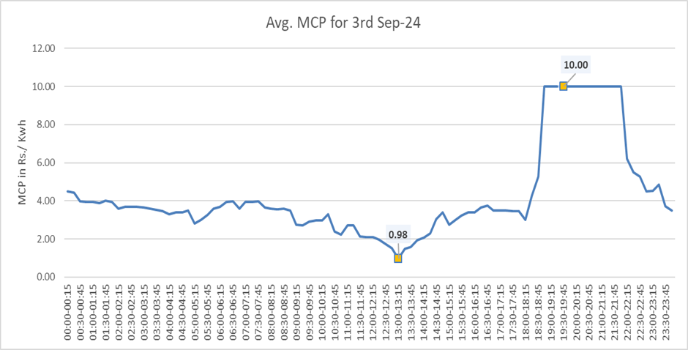
Graph showing the fluctuations in Area Clearance Price (ACP) over a single day, divided into 15-minute time intervals

Slide 5
Thank You

